Slide 1
fmt package
fmt package, variadic

Slide 2
fmt package

Slide 3
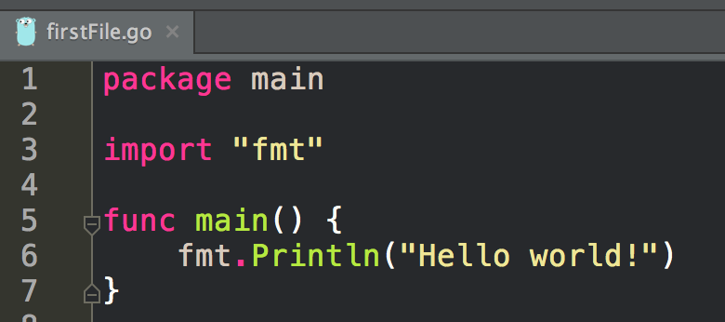
We have been using fmt.Println

Slide 4
http://godoc.org/fmt
let’s look at this package

Slide 5
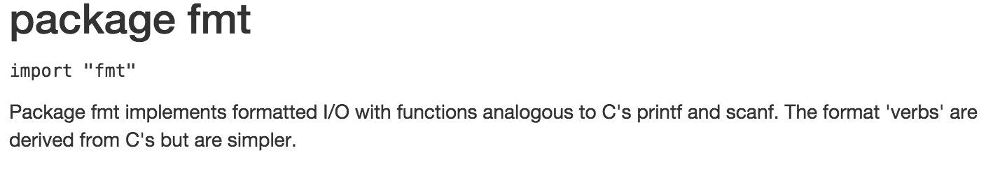

Slide 6
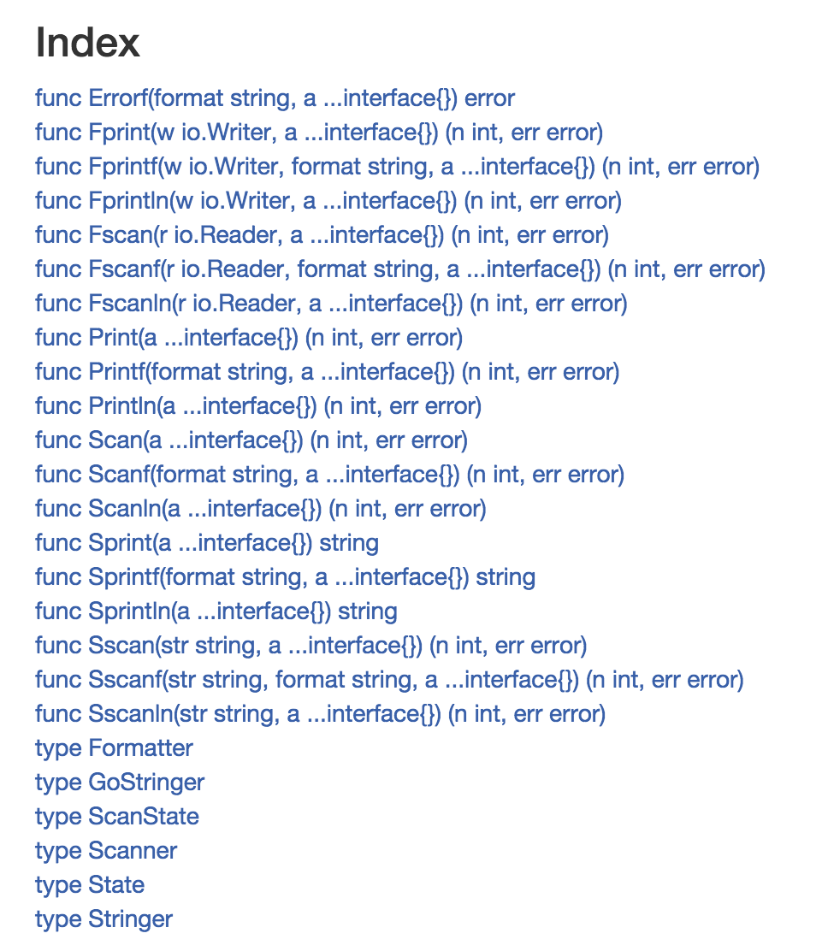
What do these do?

Slide 7
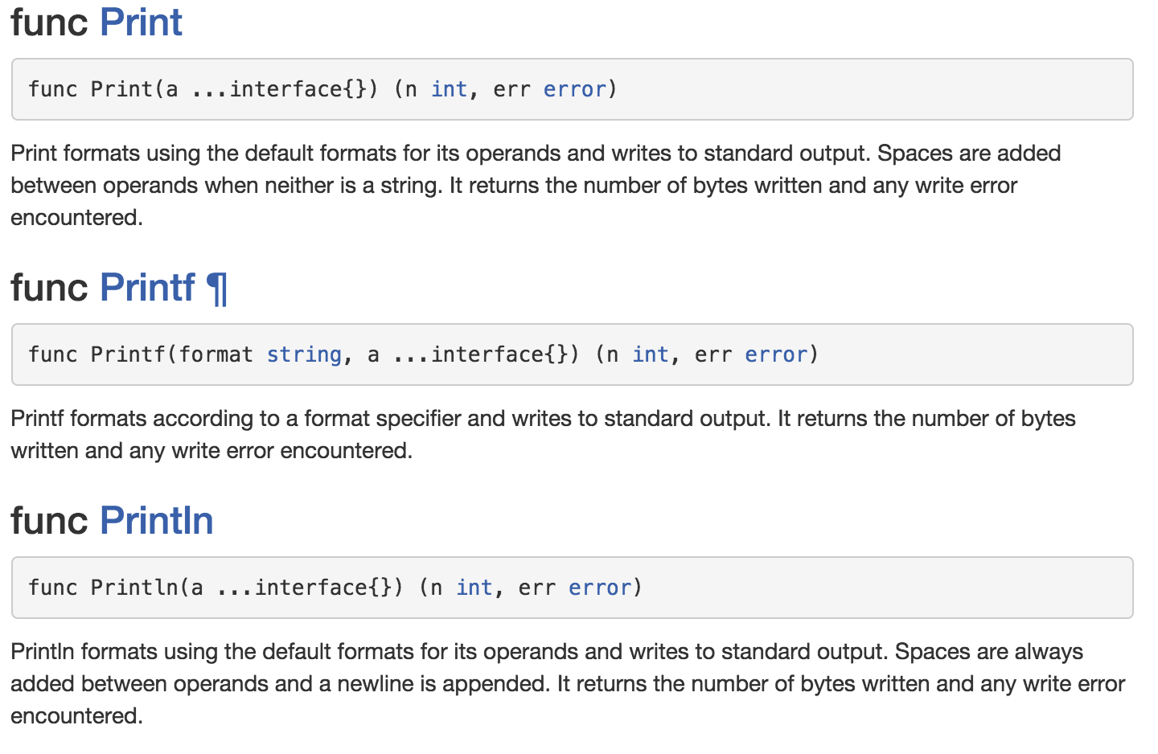

Slide 8
what do these … mean?

Slide 9
variadic
...params
args...
what does “…” mean in English?
it means there’s more, or there was more, or there was more here, doesn’t it?
example: The president said, “In these hard times … we all need to help.”
example: There were many options: cheese, wine, bread ….
example: … until the end of time.

Slide 10
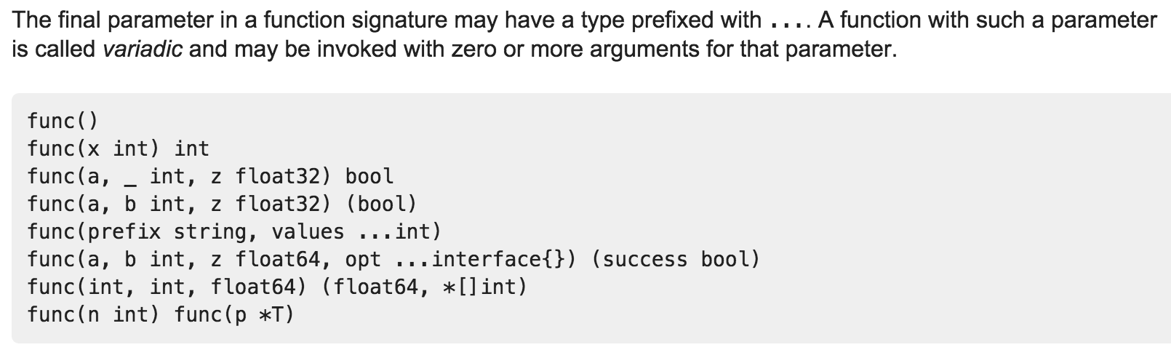
https://golang.org/ref/spec#Function_types

Slide 11
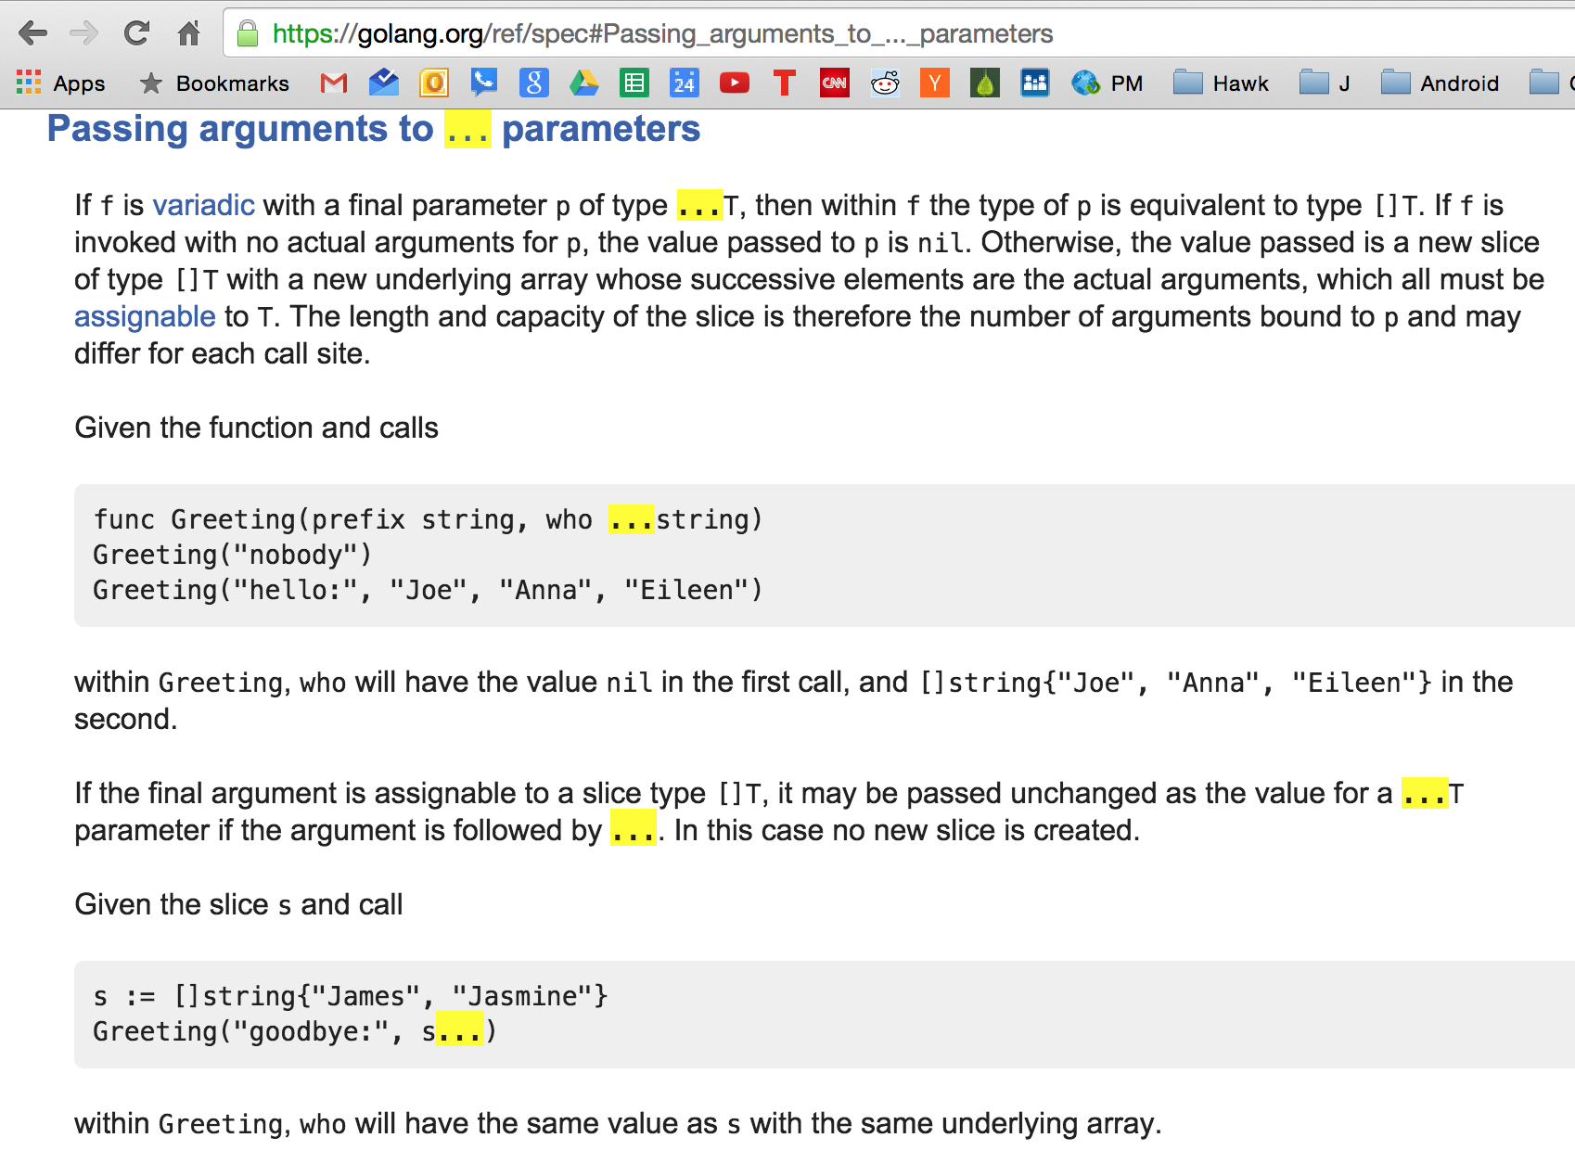
https://golang.org/ref/spec#Function_types

Slide 12
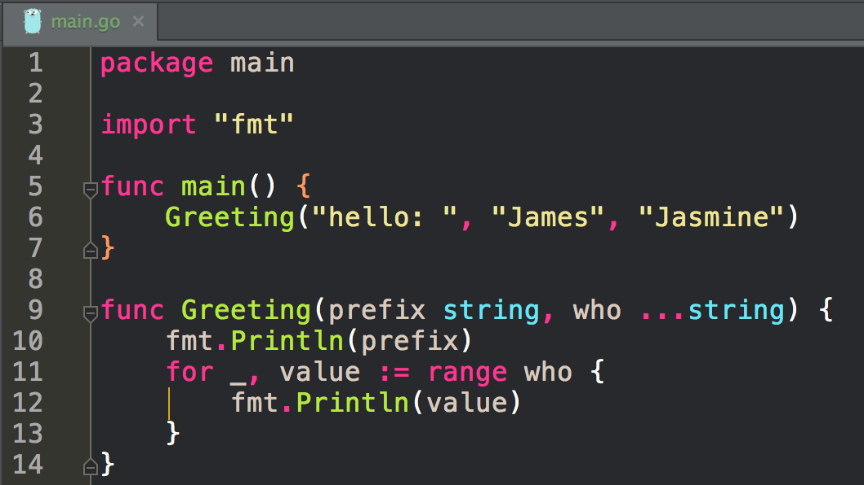
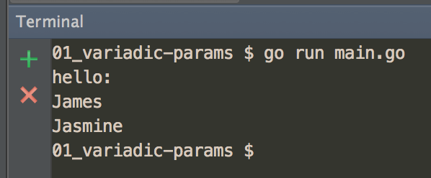

Slide 13
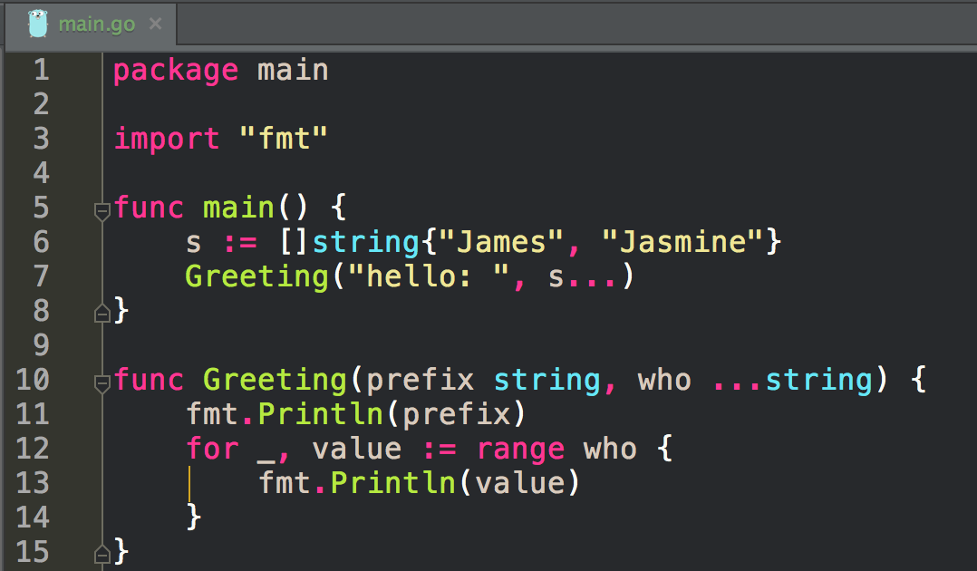
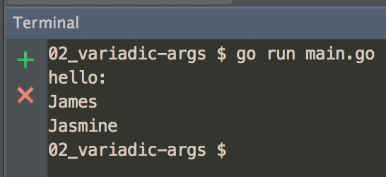

Slide 14
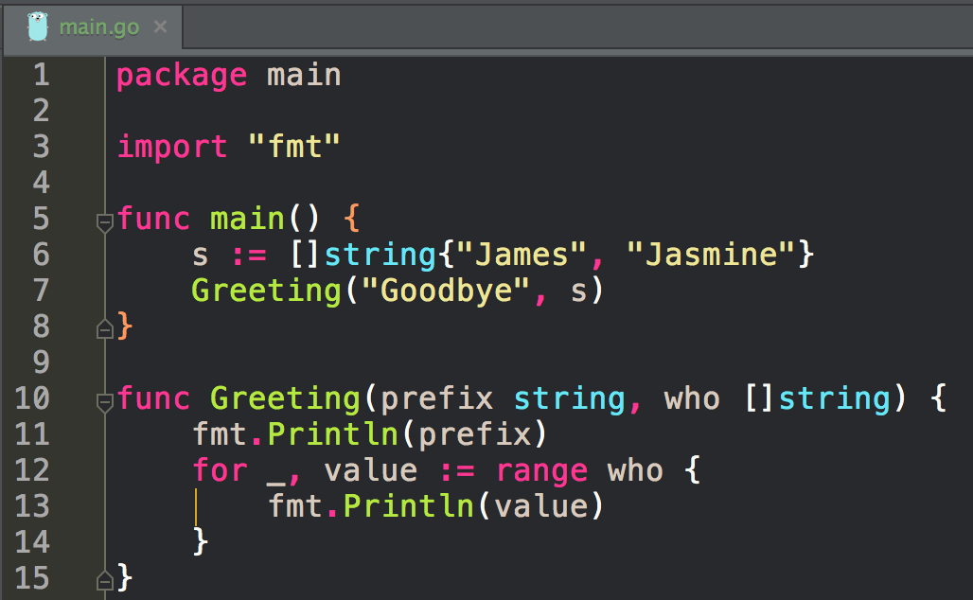
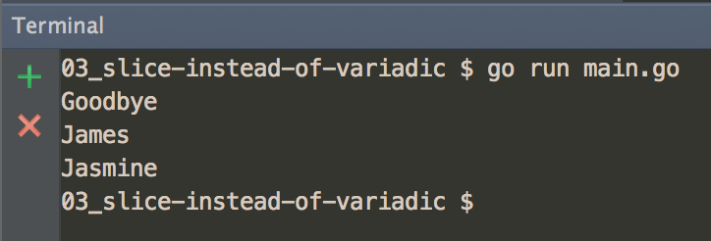

Slide 15
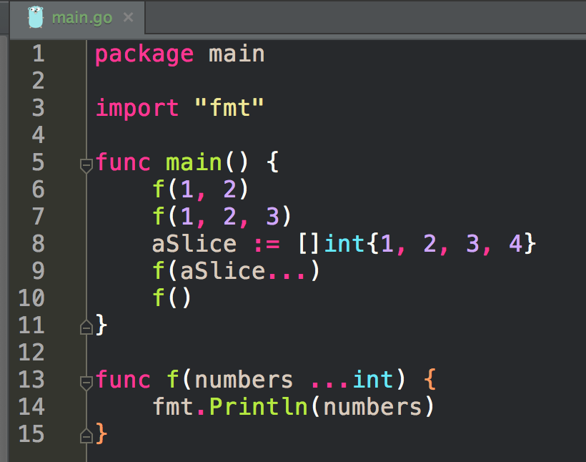
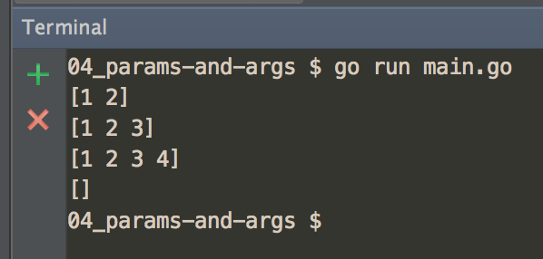

Slide 16
exercise
create a program
that uses variadic params and variadic args

Slide 17
exercise
create a program
that uses a slice of ints param
and a slice of ints arg

Slide 18
fmt package
back to the fmt package

Slide 19
saw this

Slide 20
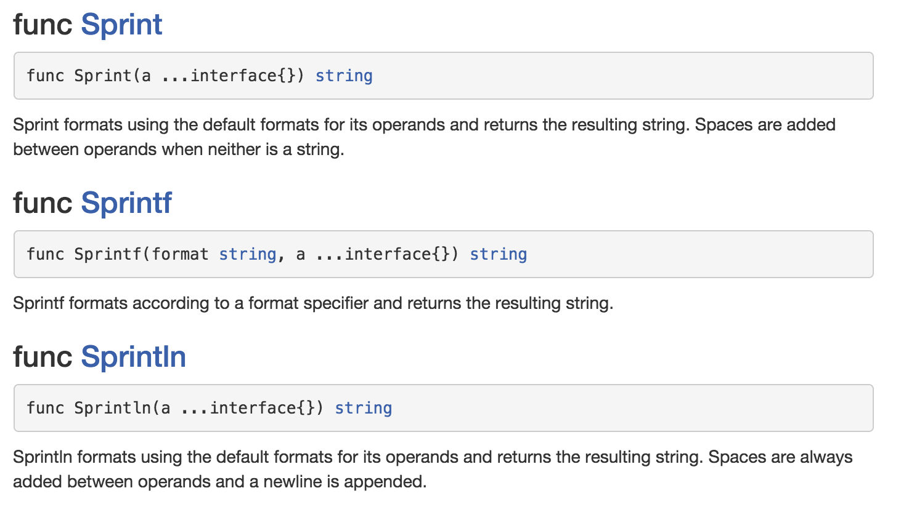

Slide 21
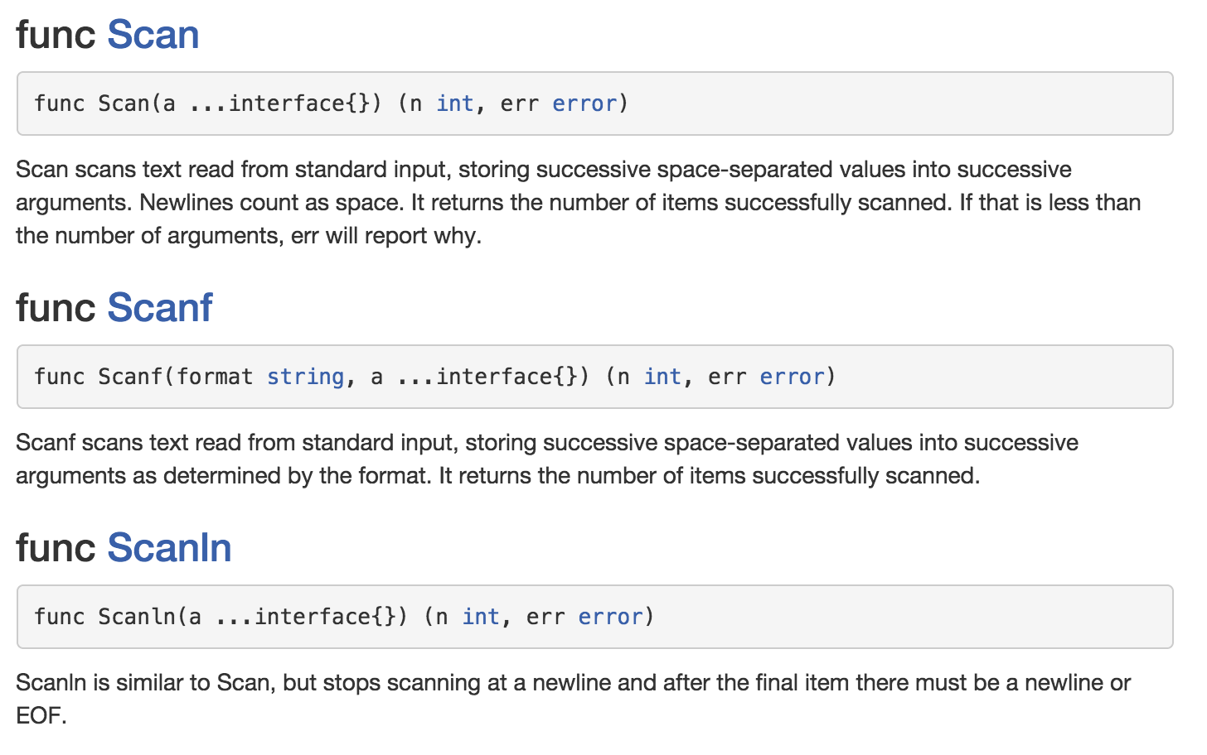

Slide 22
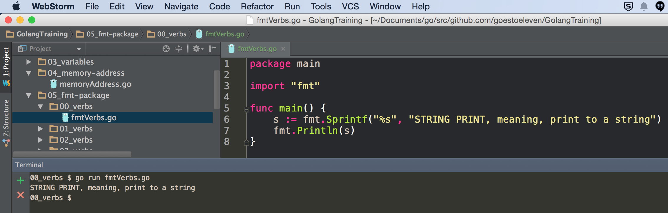

Slide 23
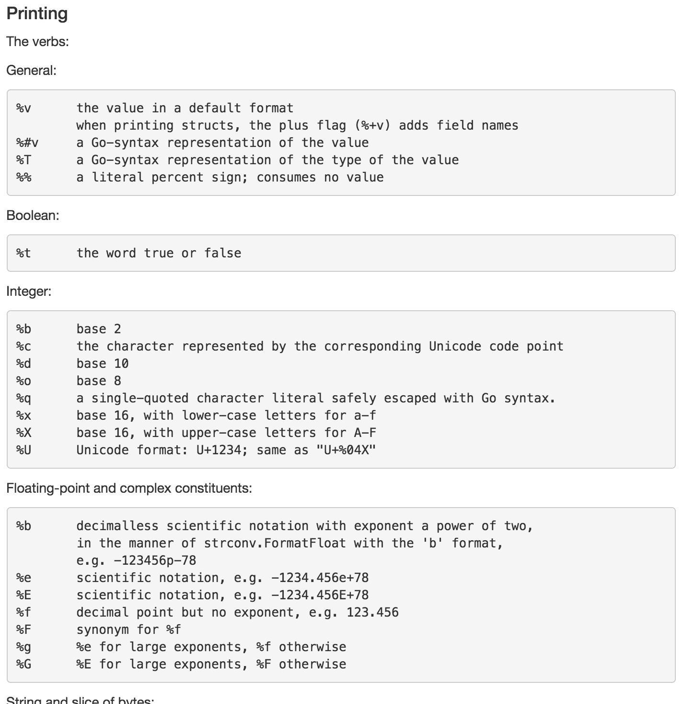

Slide 24
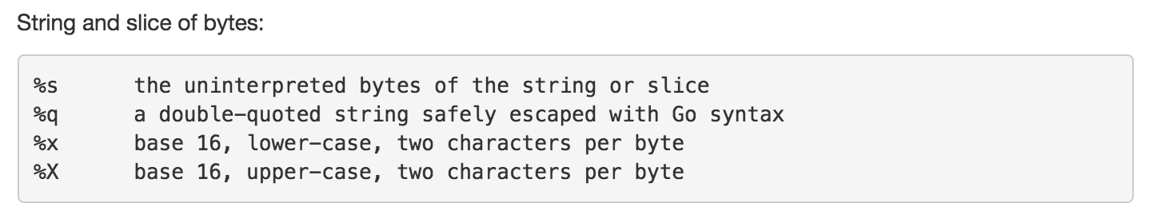

Slide 25
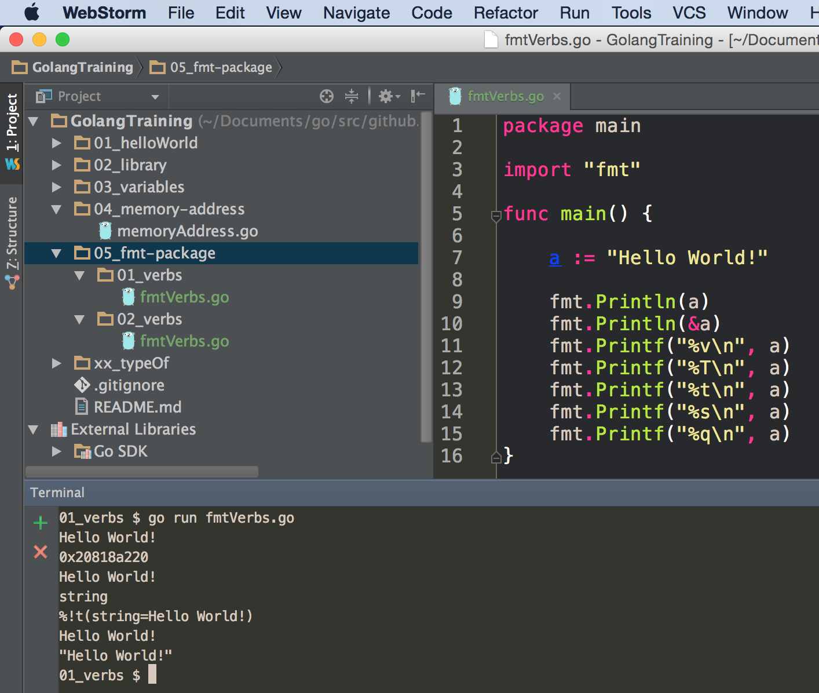

Slide 26
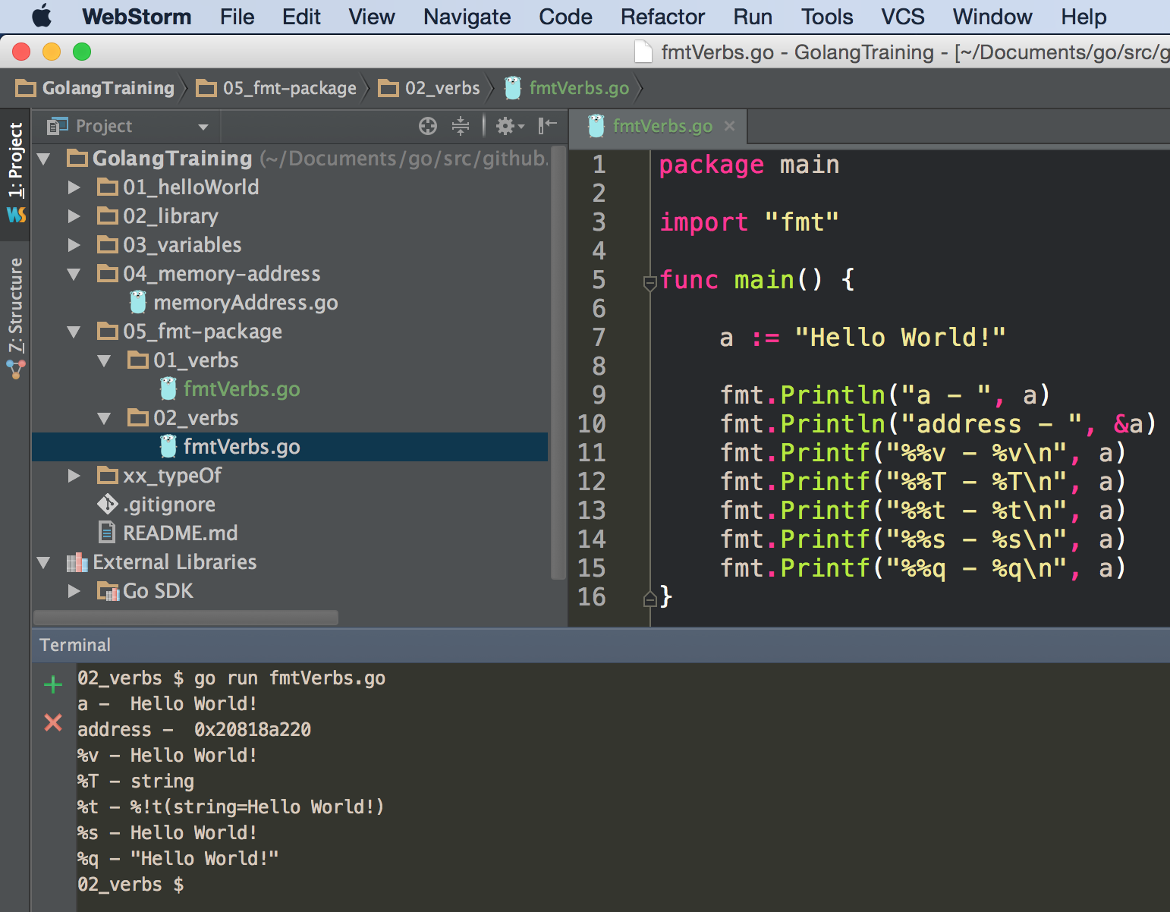
%% just prints %

Slide 27
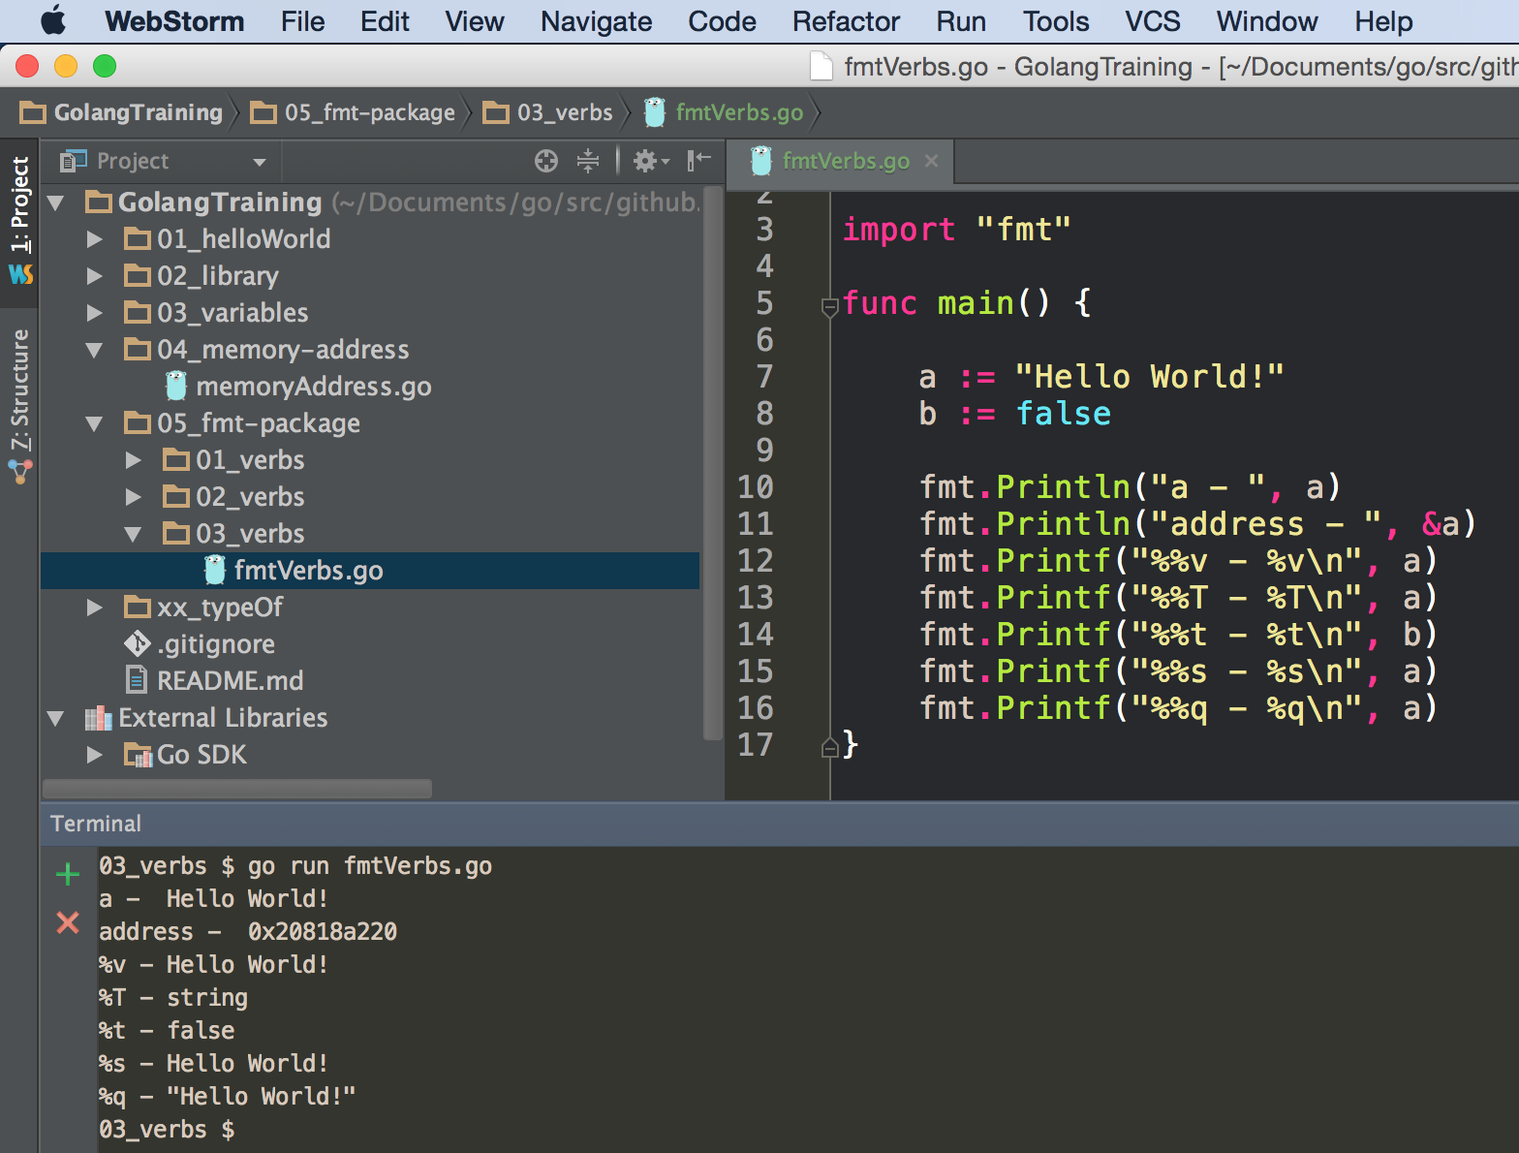

Slide 28
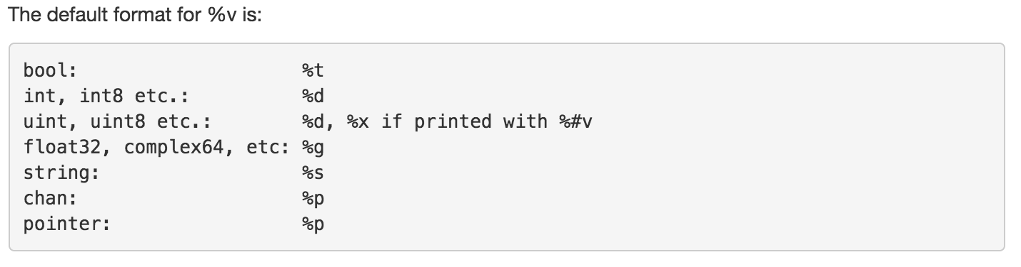
%v

Slide 29
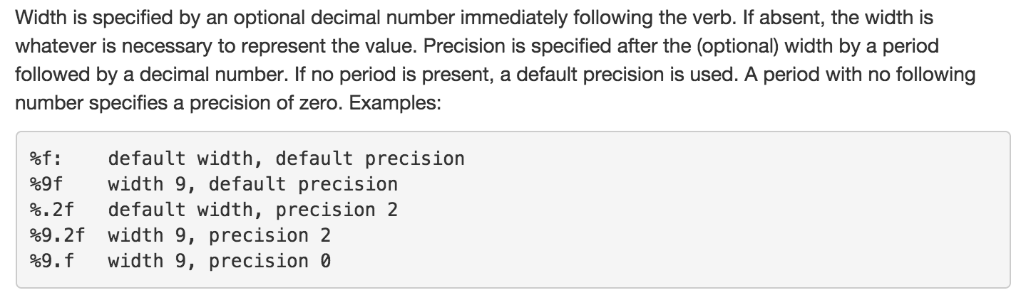
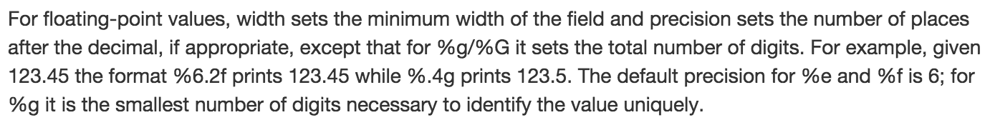

Slide 30
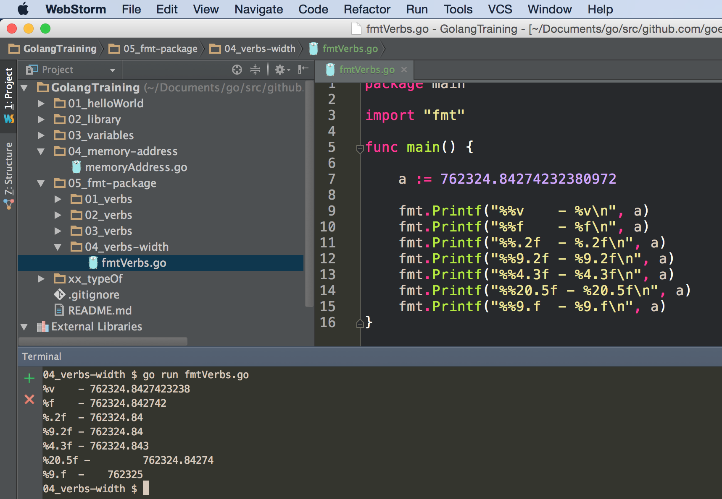

Slide 31
examples of other verbs
https://raw.githubusercontent.com/GoesToEleven/GolangTraining/master/15_fmt-package/05_verbs/goByExample.go

Slide 32
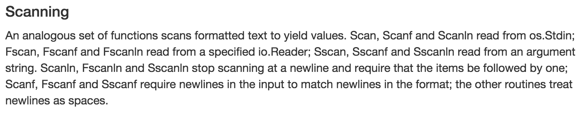
os.Stdin
What is standard input for your
operating system?
F as in File
“... read from a specified io.Reader …”
io as in input output

Slide 33
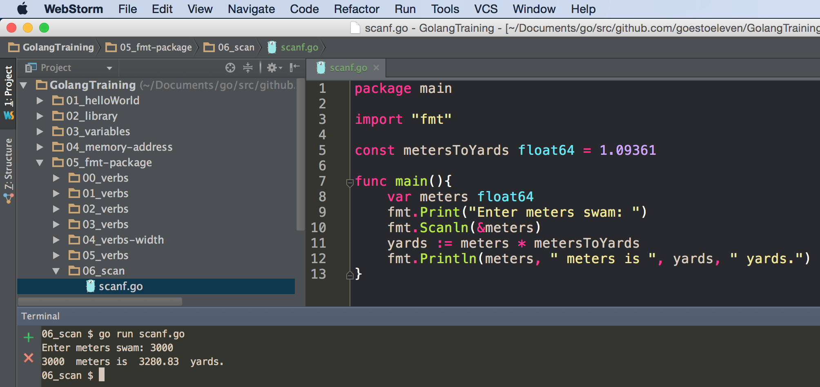

Slide 34
exercise
create a program
that uses fmt.Scanln to receive keyboard input
does some calculation using that input
and then uses fmt.Println to display results

Slide 35
Review
fmt package
Print
Print
Printf
Println
Scan
Scan
Scanf
Scanln
Sprint
Sprint
Sprintf
Sprintln
variadic
func sum(numbers ...int) {
}
sum(aSlice...)
verbs
%v
receiving user input
var meters float64 fmt.Print("Enter meters swam: ") fmt.Scanln(&meters)
http://godoc.org/reflect
fmt.Println("a - ", reflect.TypeOf(a), " - ", a)

Slide 36
Review Questions

Slide 37
fmt package
Describe the difference between Print, Printf, and Println

Slide 38
fmt package
What are formatting verbs and how are they used?
What is the default formatting verb?

Slide 39
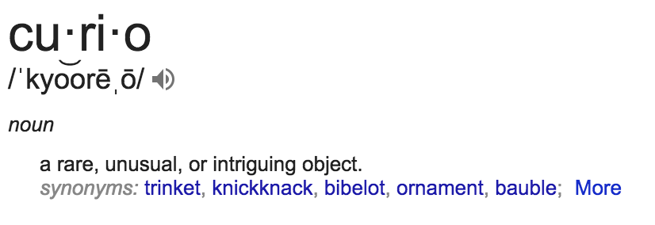
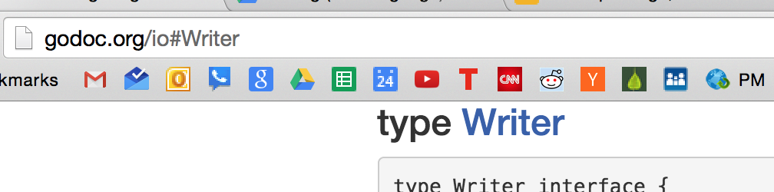
fmt package
What is the difference between Print, Fprint, & Sprint?
Read the documentation
describe how Sprint is used
provide a screenshot of code you wrote to illustrate Sprint
speculate as to how Fprint might be used
What is an io.Writer
describe an io.Writer using quotes from the documentation
take a screenshot of the io.Writer source code and include it as a curio in your description
(a curio is something that you don’t understand yet but which is interesting)
click that to get to source code:

Slide 40
fmt package
What is the difference between Scan, Fscan, & Sscan?
Read the documentation
describe how Sscan is used
provide a screenshot of code you wrote to illustrate Sscan
speculate as to how Fscan might be used
What is an io.Reader
describe an io.Reader using quotes from the documentation
take a screenshot of the io.Reader source code and include it as a curio in your description

Slide 41
fmt package
Describe what Sprint does.
Provide a screenshot of code you wrote to illustrate your description.

Slide 42
variadic
Describe the difference between variadic params & variadic args.
Provide a screenshot of code you wrote to illustrate your description.
...params
args...

